Slide 1
Colorize Black and White Images Using CNN
Rajeev Meda

Slide 2
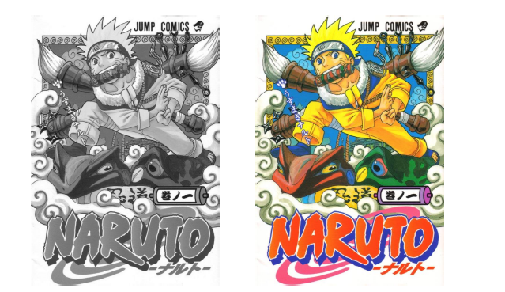
Motivation
Colorize comics
CNN beyond classification

Slide 3
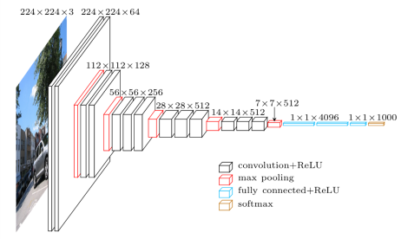
How it is done?
Use VGG-16 pertained model
Network loses localization information
[1] Image taken from https://blog.heuritech.com/2016/02/29/a-brief-report-of-the-heuritech-deep-learning-meetup-5/

Slide 4
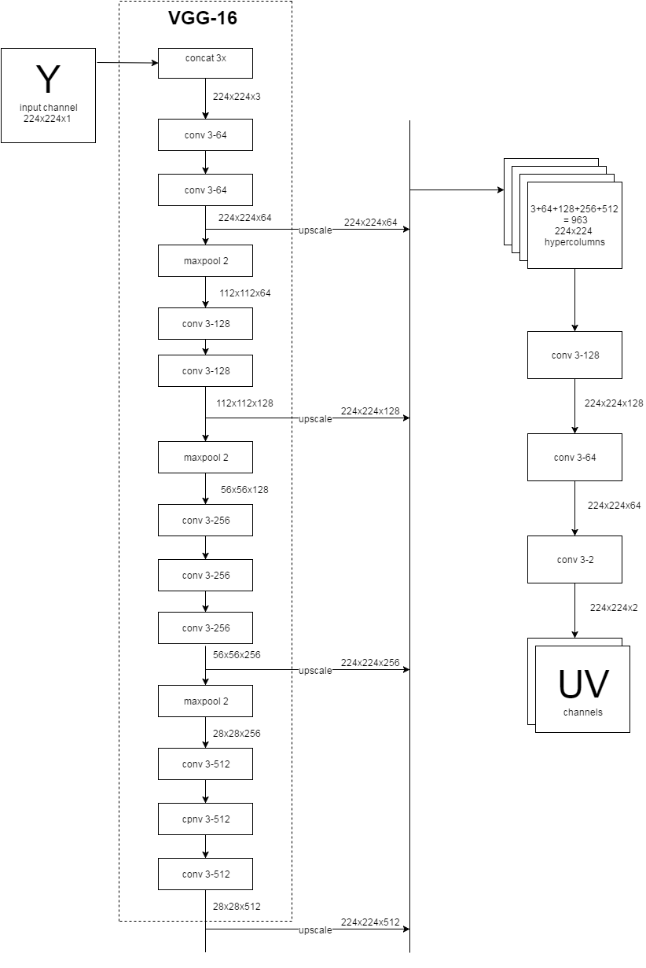
Hypercolumns
A hypercolumn for a pixel in the input image is a vector of all the activations above that pixel.
Preserves localization information
Upscale each conv layer before max pool to 224x224 dimension.
Intuitively bit like spatial pyramid model
Lot of memory needed for computaion
[2] Bharath Hariharan, Pablo Arbeláez, Ross Girshick, Jitendra Malik, Hypercolumns for Object Segmentation and Fine-grained Localization

Slide 5
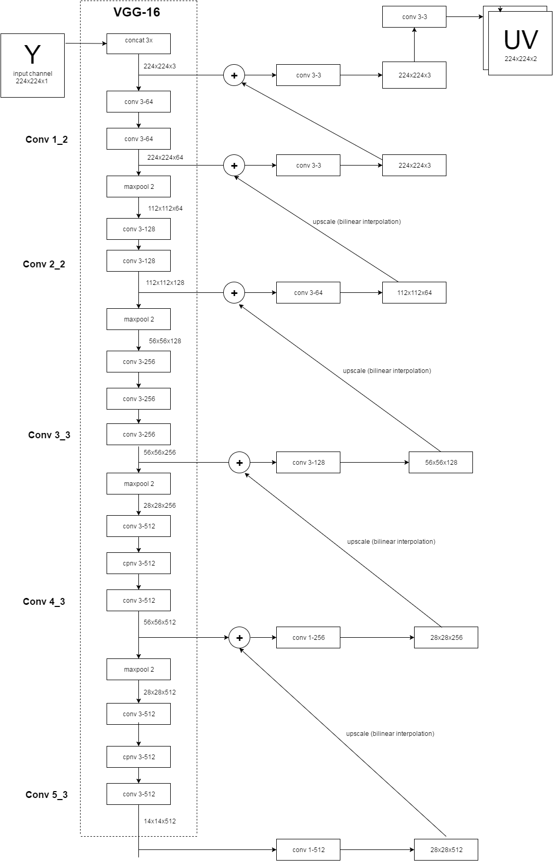
Hackey method
Used concept similar to that of ResNet developed by Kaiming He et al.
Less memory for parameters.
Better convergence.
[3] Model inspired from http://tinyclouds.org/colorize/

Slide 6
Implementation
Tensorflow
Amazon g2.x2large instance
Images from Naruto comic as dataset
Batch size 1 image
Gradient Descent - 0.001 learning rate
Euclidian distance loss function

Slide 7
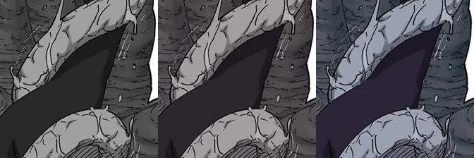
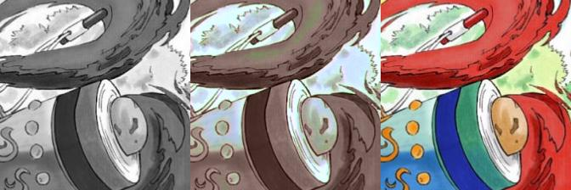
Results

Slide 8
